Slide 1









HOUSE Of
DEVELOPERS

Slide 2

Preliminary Analysis:
An employee of a government agency named Ms Oprah has been in the midst of a devastating malware attack.
Machines in the office have been
Crashing
Error Messages
Failed Logins
Overall machine compromisation
From the training data we observed that:
Given files were heavy in data, but main focus/target variable was “malware status”.
We were able to analyse the target variable using machine learning algorithm models.
Many models could be used such as “Logistic Regression”,”XGBoost” and others based on the comparison type.
For our analysis we choose “XGBoost” as we had only one target variable in a 1-Dimensional Dataframe for the ML Algorithm.
HOUSE Of
DEVELOPERS

Slide 3
Method Used/Implemented:
First we imported the 50 given .csv files and using “pd.concat()” and merged into one file
Used “XGBoost” Machine Learning Algorithm on Training first.
We had used Logistic Regression as well.
Under XGBoost different variations could be used but XGRClassfier() proved to be useful.
XGB was used as it had the capacity to boot up the heavy dataset efficiently.
Split the data into a ratio of 80:20 where 80 was for testing and 20 was for training.
We ran the algorithm taking input “x” using which every column was tested/ deep learned on the column “malware_status”.
Once the ML algorithm was set used the training data, we run it on the testing data.
Fine-Tuned our model by changing the hyper-parameters by learning the rate, n-estimators, maxdepth and min child weight
Following are the results of the run on Kaggle:
HOUSE Of
DEVELOPERS

Slide 4
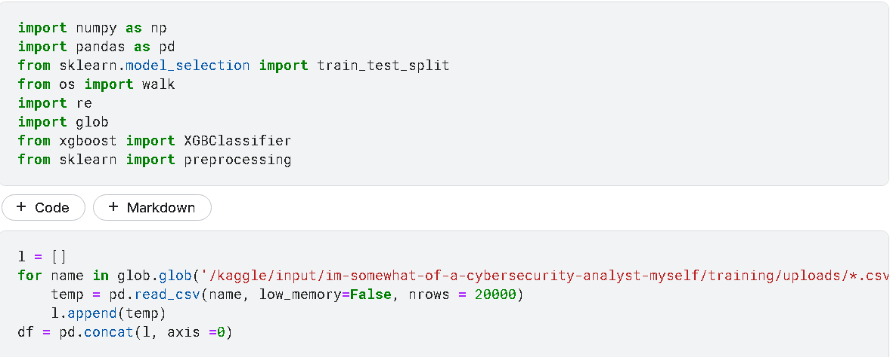
Steps:
import necessary libraries
Use a list to collect all 50 csv files and append using pd.concat()
HOUSE Of
DEVELOPERS

Slide 5
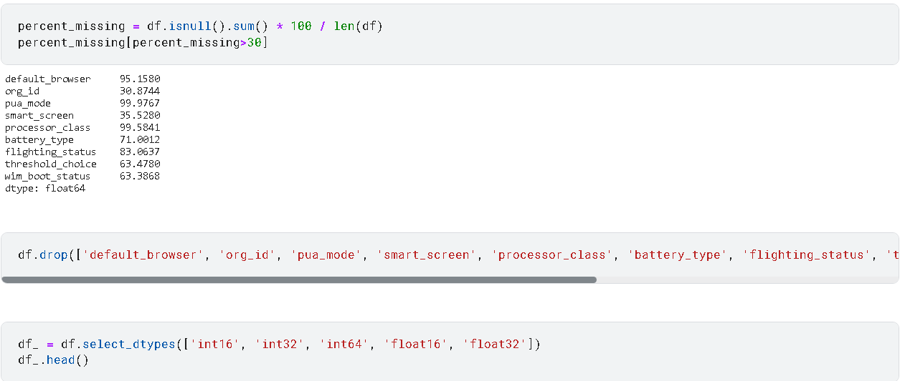
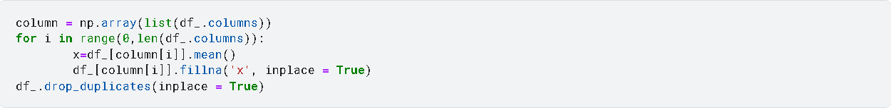
Clean the data and replace necessary NaN values as shown:
HOUSE Of
DEVELOPERS

Slide 6
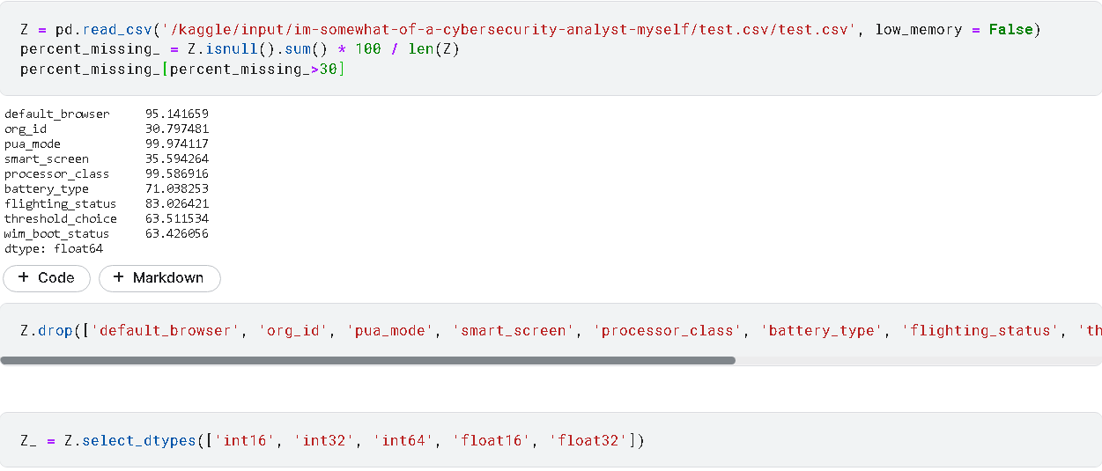
Do the same with the “Test” files
HOUSE Of
DEVELOPERS

Slide 7
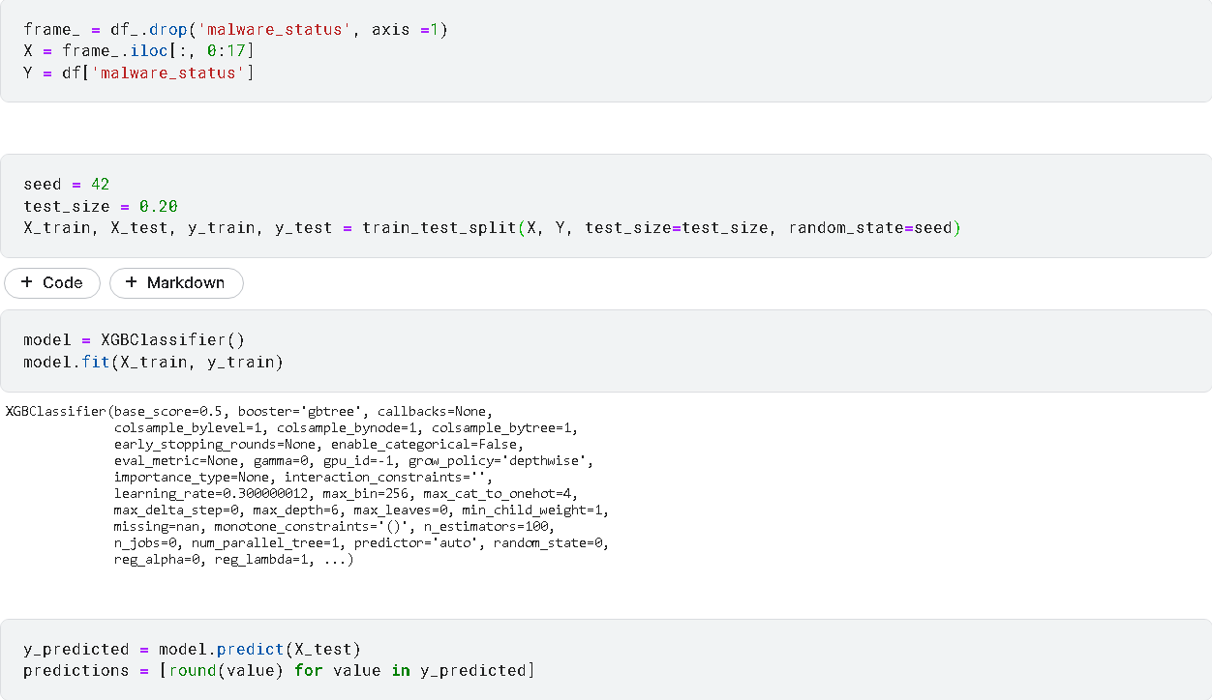
Applying “XGBooster” ML Algorithm, taking Y as “malware_status”:
HOUSE Of
DEVELOPERS

Slide 8

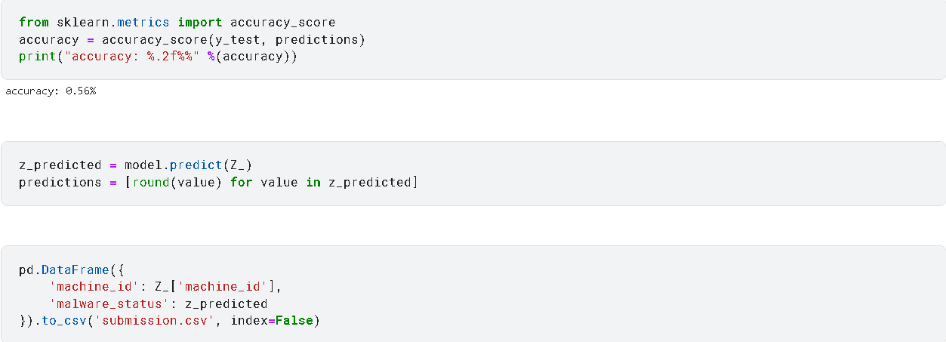

Applying “sklearn.metrics” to calculate the accuracy and convert the predicted values into a .csv file as shown:
HOUSE Of
DEVELOPERS

Slide 9
Thank You

